Slide 1
Assignment #10 IE5351 Introduction to Systems Engineering
Team II Members
Noran Abulaila (noran.abulaila@mavs.uta.edu)
Lekhya Sindura Nadella (lxn8999@mavs.uta.edu) (Point of Contact)
Gopal Penmetsa (gkp8869@mavs.uta.edu)

Slide 2
Assignment Tasks
Part I: Use Case Diagram
Develop a use case diagram that contains at least 5 core functions of the food delivery drone. Show at least one inclusion and one extension. Identify and define the actors. Note that the drone should be able to use multiple means to travel to its location (fly, drive on roadway, transit via water). It should also be able to handle payment for the food if payment has not been already made.
Develop 2 of the use cases (from your team use case diagram) in text form, detailing items such as the pre and post conditions, main success scenario (primary flow). Justify why this is a complete use case.
Part II: Requirement Diagram
Develop requirement diagrams for a subset of your team’s requirements (at least 6 requirements) for the food delivery drone system.
Show an example of the containment, derive, refine, satisfy, verify, copy, and trace relationships to other model elements. Show examples where you demonstrate the three different ways of representing the relationships (directly, compartment, and callout). You may create more than one requirement diagram to illustrate the relationships.
Show the requirements for your food delivery drone system using requirements tables. In one table show the decomposition of at least one requirement. In another show either a satisfy or derive dependency relationship.
01

Slide 3
Use Case Diagram
Part I
Use cases diagram can be viewed as a mechanism to capture system requirements in terms of the uses of the system (Friedenthal et al., 2009). On the use case diagram:
The frame represents a package or block.
The content of the diagram describes a set of actors, use cases and relationships between them.
02

Slide 4
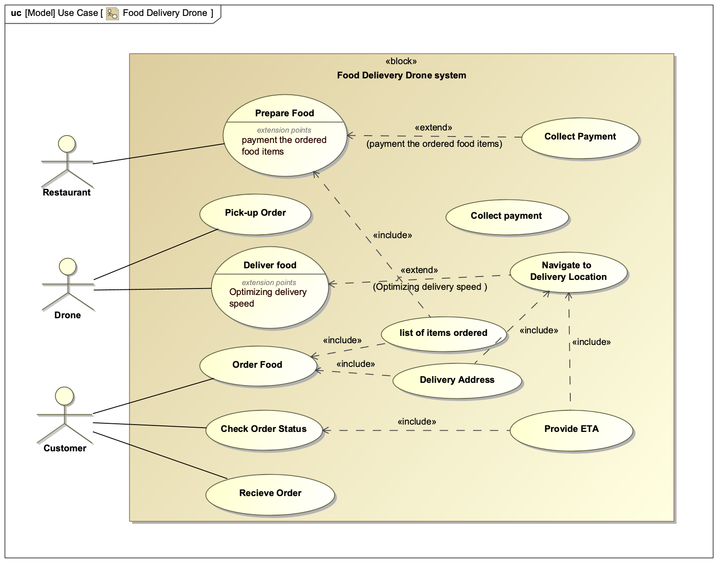
Use Case Diagram
03

Slide 5
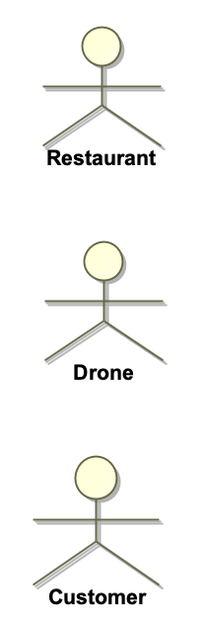
Use Case Diagram: Actors
Place which prepares and serves the food to customers on-demand.
System which delivers food from restaurant to the customer.
Persons who orders food from the restaurant.
04

Slide 6
Use Cases: Processing order & Packaging
Actors: Customer, Restaurant, Drone
Pre-Condition:
1. Customer can only view restaurants within drone deliverable range.
2. All the items must be available at the restaurant.
3. Payment must be successful before the food is prepared.
Main Success Scenarios:
1. Customer places the order and makes the payment.
2. Restaurant confirms the order and packages the food.
3. Drone picks up the food from the restaurant.
Post-Condition:
1. All food items must be properly packed to limit the spillage during transport.
2. Weight of the package must not exceed the payload limit of the drone.
3. Size of the package must be within the manageable limit of the drone.
05

Slide 7
Use Case: Transportation & Order Delivery
Actors: Restaurant, Drone, Customer
Pre-Condition:
1. Exact location details must be known.
2. Food must properly packed and be ready for the pick-up.
3. Weather conditions should be acceptable for the drone to operate.
Main Success Scenarios:
1. Drone picks up the order.
2. Drone navigates to the location.
3. Customer receives the order.
Post-Condition:
1. Delivery must be made at the exact location provided by the customer.
2. Delivery must be completed within acceptable time interval.
3. Food items must remain intact for consumption.
06

Slide 8
Requirement Diagram
Part II
Requirement diagram is graphical depiction of hierarchies of specifications or requirements captured in SysML and it is useful for representing the traceability of a single requirement to examine how that requirement is satisfied, verified, refined, and to examine its derived relationships with other requirements (Friedenthal et al., 2009).
07

Slide 9
Requirements
1. Drone shall be able to carry a payload of weight up to 10lbs.
2. Drone shall be able to carry a payload of dimensions up to 5ltr.
3. Drone shall have on-board navigation.
4. Drone shall have the ability to travel via air, water and road.
5. Drone shall update it's current location through out its journey.
6. Drone shall update the customer upon arrival.
08

Slide 10
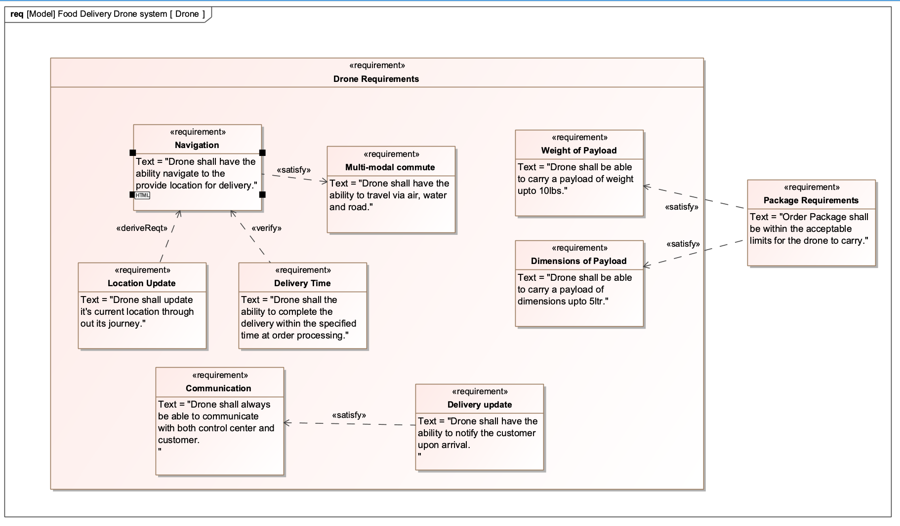
Requirement Diagram
09

Slide 11
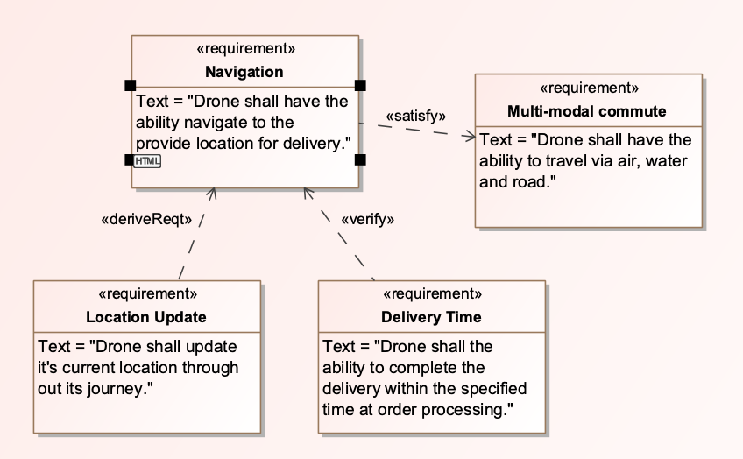
Requirement Decomposition
Requirement: Navigation
Drone must be able to navigate to the delivery location after picking up the food from the restaurant and shall have the ability to pick the shortest route to optimize the delivery time.
10

Slide 12
Requirement Decomposition
Requirement Relations
The requirement navigation also derives the requirement location update for which the drone should update its location throughout its commute.
The requirement navigation shall also verify the requirement of delivery time for which the systems provide expected time of delivery to the customer upon order processing.
The requirement multi-modal commute must be satisfied by navigation.
11

Slide 13
References
Friedenthal, S., Moore, A., & Steiner, R. (2009). A practical guide to SysML: The Systems Modeling language. Morgan Kaufmann Object Management Group/Elsevier.
12

